Slide 1

INFRASTRUCTURE
as CODE
Running Microservices on AWS with Docker, Terraform, and ECS

Slide 2
Why infrastructure-as-code matters: a short story.

Slide 3
You are starting a
new project

Slide 4

I know, I’ll use Ruby on Rails!

Slide 5
> gem install rails

Slide 6
> gem install rails
Fetching: i18n-0.7.0.gem (100%)
Fetching: json-1.8.3.gem (100%)
Building native extensions. This could take a while...
ERROR: Error installing rails:
ERROR: Failed to build gem native extension.
/usr/bin/ruby1.9.1 extconf.rb
creating Makefile
make
sh: 1: make: not found

Slide 7
Ah, I just need to install make

Slide 8
> sudo apt-get install make
...
Success!

Slide 9
> gem install rails

Slide 10
> gem install rails
Fetching: nokogiri-1.6.7.2.gem (100%)
Building native extensions. This could take a while...
ERROR: Error installing rails:
ERROR: Failed to build gem native extension.
/usr/bin/ruby1.9.1 extconf.rb
checking if the C compiler accepts ... yes
Building nokogiri using packaged libraries.
Using mini_portile version 2.0.0.rc2
checking for gzdopen() in -lz... no
zlib is missing; necessary for building libxml2
*** extconf.rb failed ***

Slide 11

Hmm. Time to visit StackOverflow.

Slide 12
> sudo apt-get install zlib1g-dev
...
Success!

Slide 13
> gem install rails

Slide 14
> gem install rails
Building native extensions. This could take a while...
ERROR: Error installing rails:
ERROR: Failed to build gem native extension.
/usr/bin/ruby1.9.1 extconf.rb
checking if the C compiler accepts ... yes
Building nokogiri using packaged libraries.
Using mini_portile version 2.0.0.rc2
checking for gzdopen() in -lz... yes
checking for iconv... yes
Extracting libxml2-2.9.2.tar.gz into tmp/x86_64-pc-linux-gnu/ports/libxml2/2.9.2... OK
*** extconf.rb failed ***

Slide 15

nokogiri y u never install correctly?

Slide 16
(Spend 2 hours trying random StackOverflow suggestions)

Slide 17
> gem install rails

Slide 18
> gem install rails
...
Success!

Slide 19
Finally!

Slide 20
> rails new my-project
> cd my-project
> rails start

Slide 21
> rails new my-project
> cd my-project
> rails start
/source/my-project/bin/spring:11:in `<top (required)>': undefined method `path_separator' for Gem:Module (NoMethodError)
from bin/rails:3:in `load'
from bin/rails:3:in `<main>'

Slide 22


Slide 23
Eventually, you get it working

Slide 24
Now you have to deploy your
Rails app in production

Slide 25
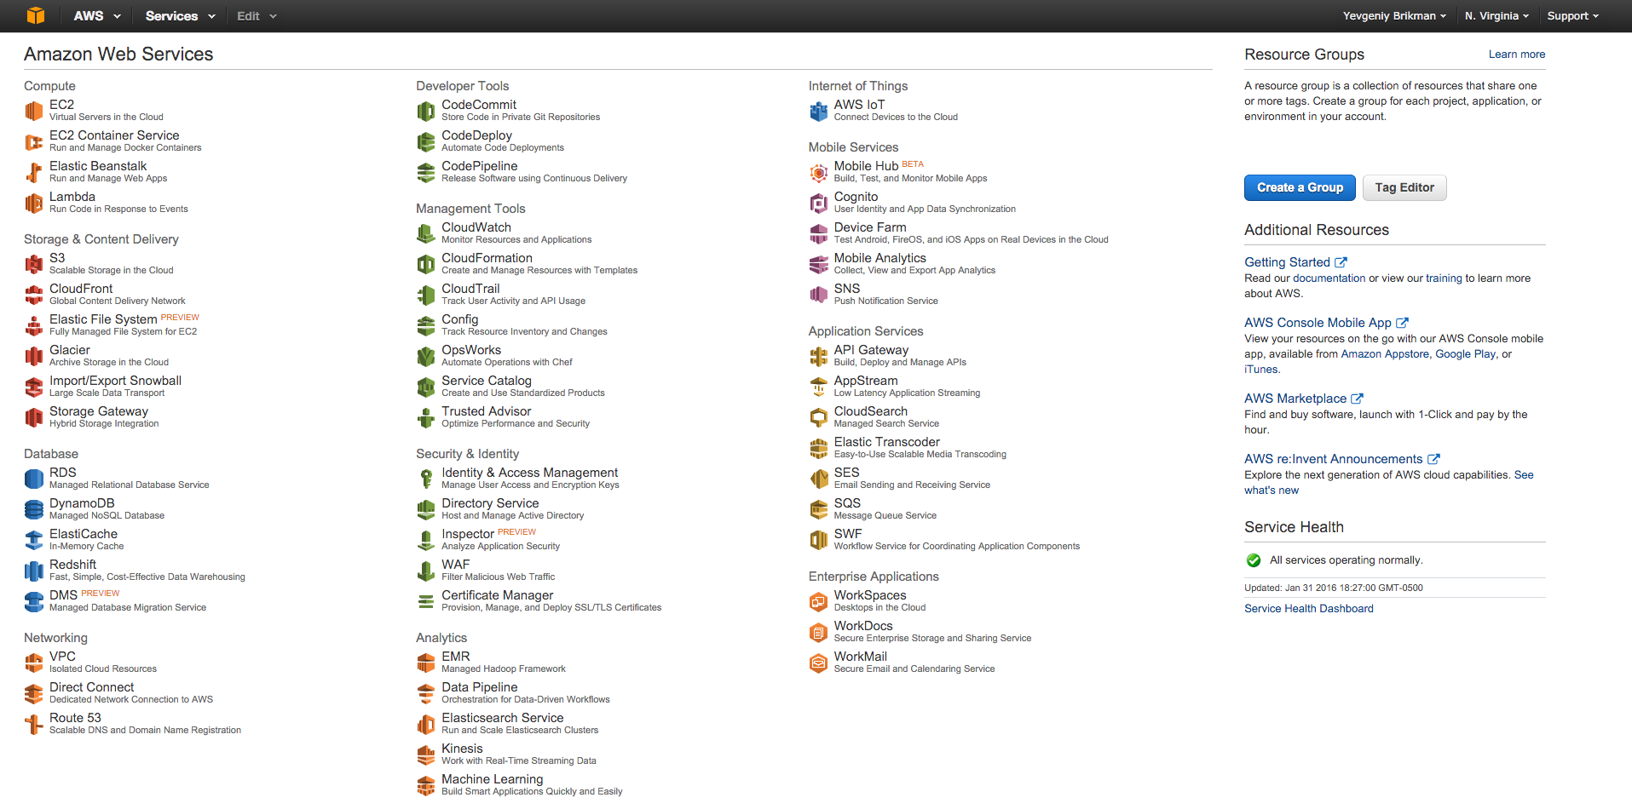
You use the AWS Console to deploy an EC2 instance

Slide 26
> ssh ec2-user@ec2-12-34-56-78.compute-1.amazonaws.com
__| __|_ )
_| ( / Amazon Linux AMI
___|\___|___|
[ec2-user@ip-172-31-61-204 ~]$ gem install rails

Slide 27
> ssh ec2-user@ec2-12-34-56-78.compute-1.amazonaws.com
__| __|_ )
_| ( / Amazon Linux AMI
___|\___|___|
[ec2-user@ip-172-31-61-204 ~]$ gem install rails
ERROR: Error installing rails:
ERROR: Failed to build gem native extension.
/usr/bin/ruby1.9.1 extconf.rb

Slide 29
Eventually you get it working

Slide 30
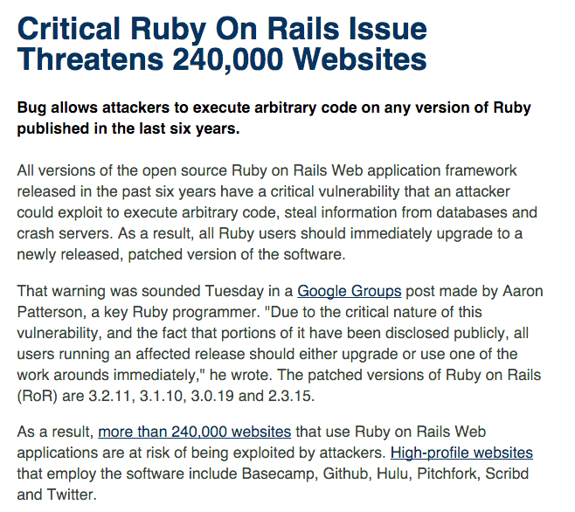

Slide 31
Now you urgently have to update all your Rails installs

Slide 32
> bundle update rails

Slide 33
> bundle update rails
Building native extensions. This could take a while...
ERROR: Error installing rails:
ERROR: Failed to build gem native extension.
/usr/bin/ruby1.9.1 extconf.rb
checking if the C compiler accepts ... yes
Building nokogiri using packaged libraries.
Using mini_portile version 2.0.0.rc2
checking for gzdopen() in -lz... yes
checking for iconv... yes
Extracting libxml2-2.9.2.tar.gz into tmp/x86_64-pc-linux-gnu/ports/libxml2/2.9.2... OK
*** extconf.rb failed ***

Slide 34


Slide 35
The problem isn’t Rails

Slide 36
> ssh ec2-user@ec2-12-34-56-78.compute-1.amazonaws.com
__| __|_ )
_| ( / Amazon Linux AMI
___|\___|___|
[ec2-user@ip-172-31-61-204 ~]$ gem install rails
The problem is that you’re configuring servers manually

Slide 37
And that you’re deploying infrastructure manually

Slide 38
A better alternative: infrastructure-as-code

Slide 39
In this talk, we’ll go through a real-world example:

Slide 40
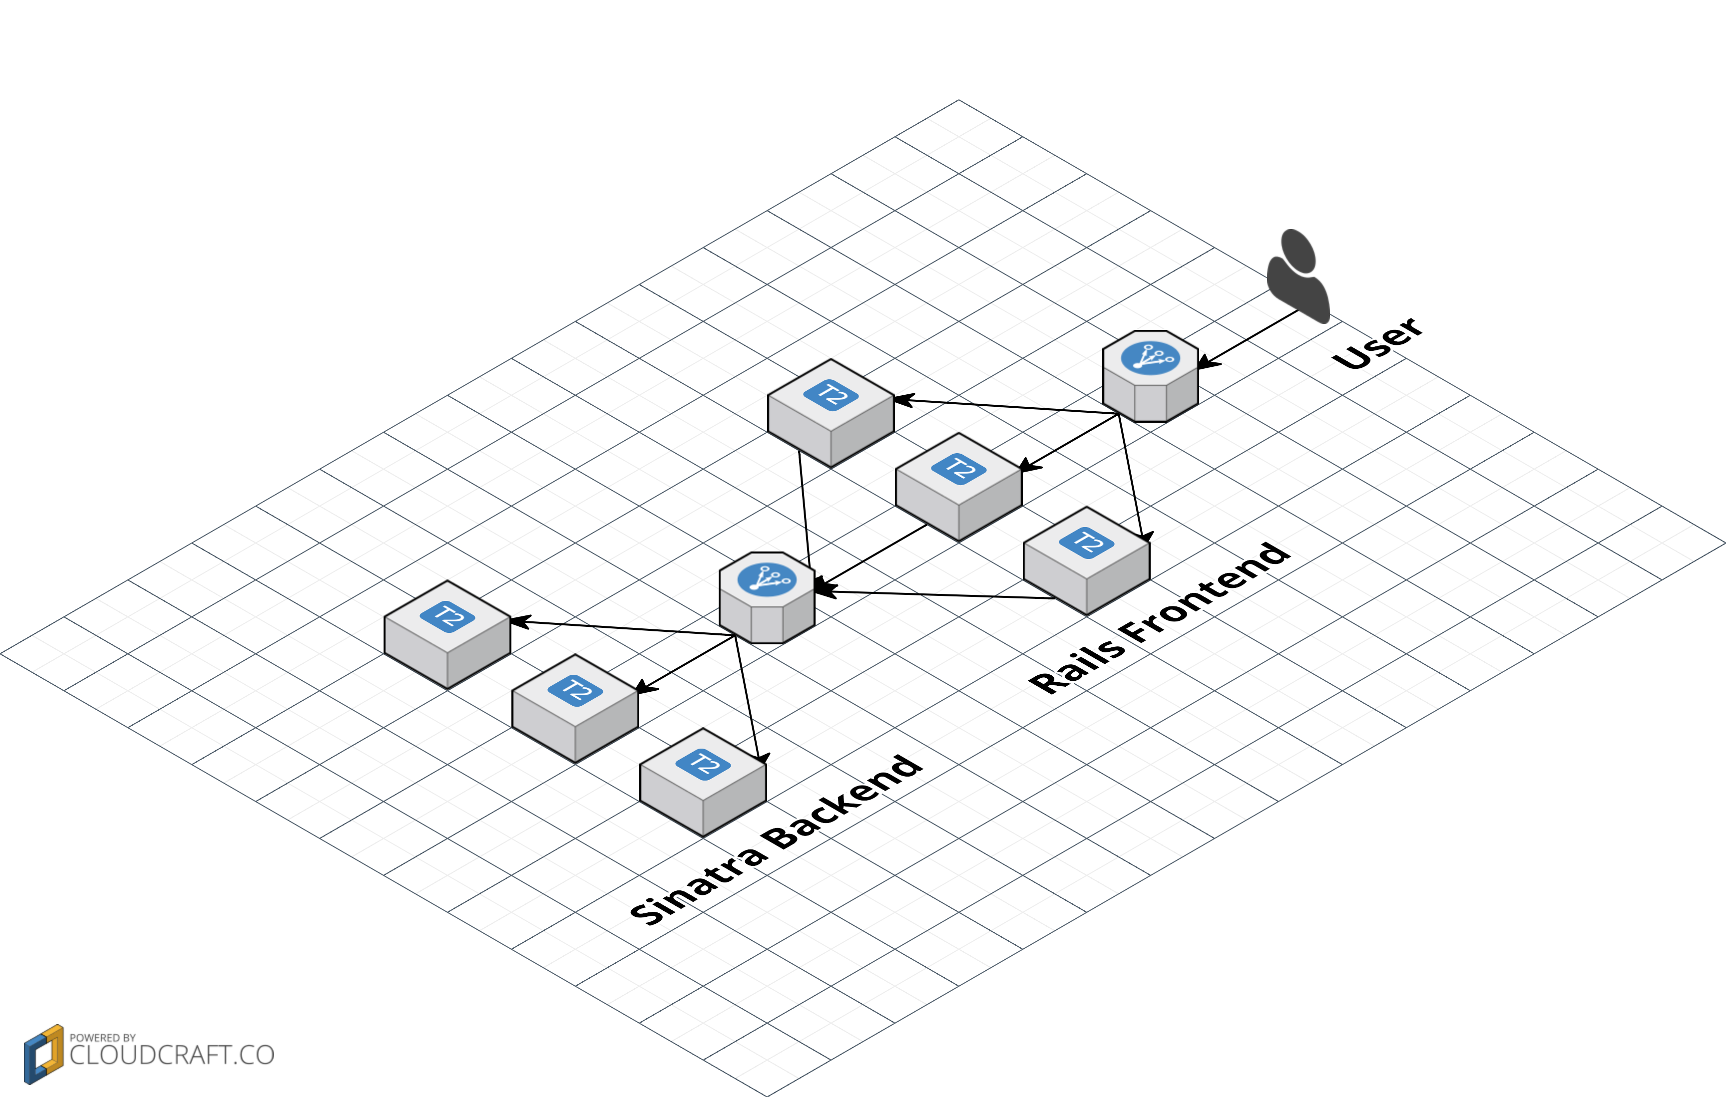
We’ll configure & deploy two microservices on Amazon ECS

Slide 41

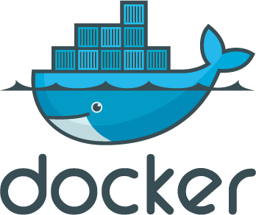
TERRAFORM
With two infrastructure-as-code tools: Docker and Terraform

Slide 42

I’m
Yevgeniy
Brikman
ybrikman.com

Slide 43

Co-founder of
Gruntwork
gruntwork.io

Slide 44
We offer DevOps
as a Service
gruntwork.io

Slide 45
And DevOps
as a Library
gruntwork.io

Slide 46





PAST LIVES

Slide 47
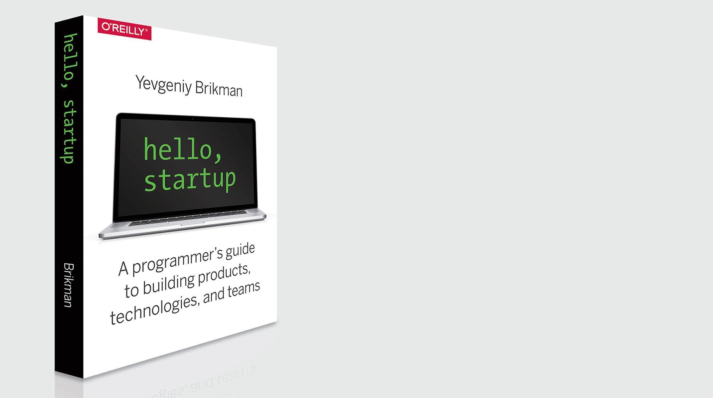
Author of
Hello,
Startup
hello-startup.net

Slide 48
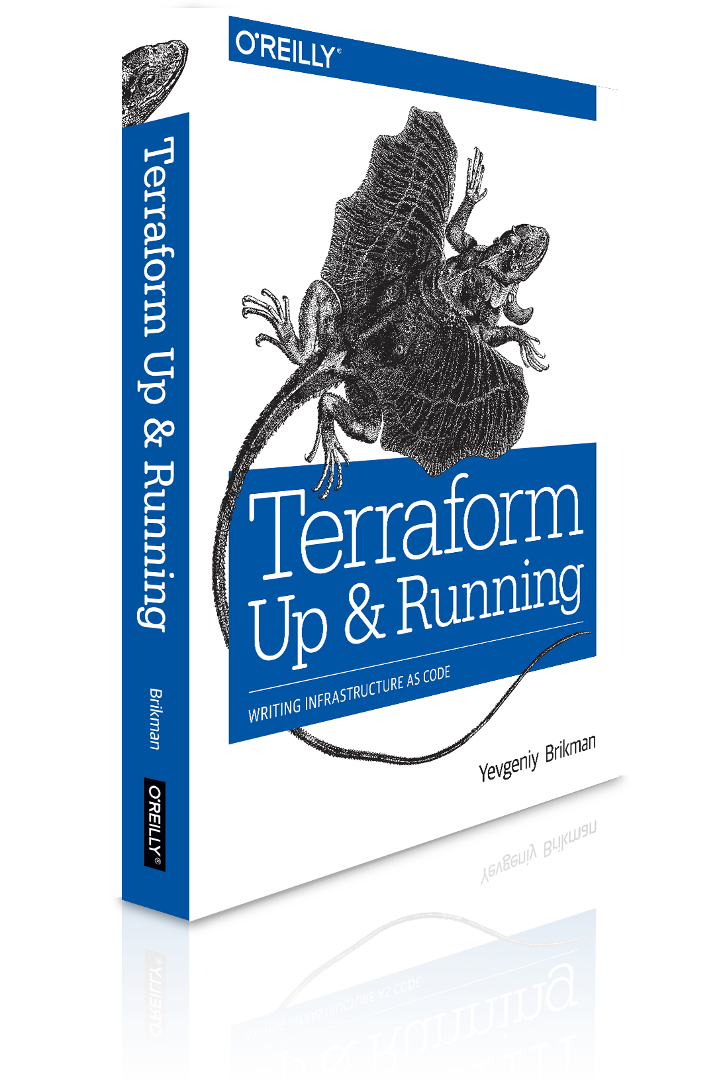
And
Terraform:
Up & Running
terraformupandrunning.com

Slide 49
Slides and code from this talk:
ybrikman.com/speaking

Slide 50

Outline
Microservices
Docker
Terraform
ECS
Recap

Slide 51
Outline
Microservices
Docker
Terraform
ECS
Recap

Slide 52
Code is the enemy: the more you have, the slower you go

Slide 53
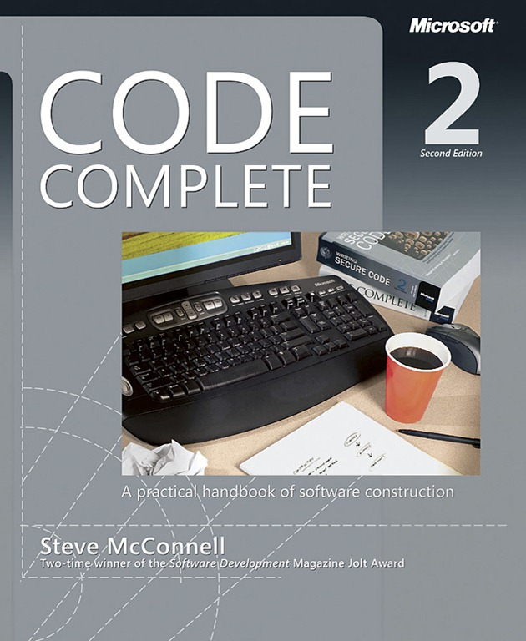
Project Size Lines of code | Bug Density Bugs per thousand lines of code
< 2K | 0 – 25
2K – 6K | 0 – 40
16K – 64K | 0.5 – 50
64K – 512K | 2 – 70
> 512K | 4 – 100

Slide 54
As the code grows, the number of bugs grows even faster

Slide 55
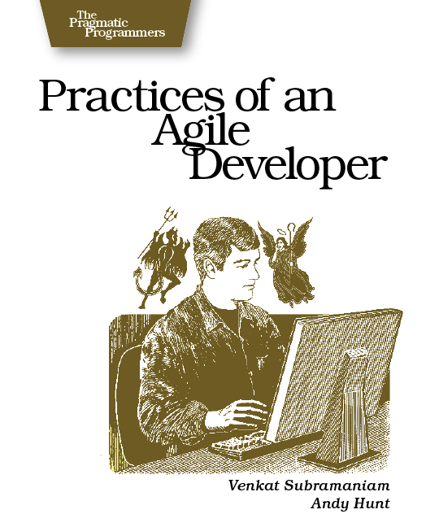
“Software development doesn't happen in a chart, an IDE, or a design tool; it happens in your head.”

Slide 56
The mind can only handle so much complexity at once

Slide 57
One solution is to break the code into microservices

Slide 58
moduleA.func()
moduleB.func()
moduleC.func()
moduleD.func()
moduleE.func()
In a monolith, you use function calls within one process

Slide 59
http://service.a
http://service.b
http://service.c
http://service.d
http://service.e
With services, you pass messages between processes

Slide 60
Advantages of services:
Isolation
Technology agnostic
Scalability

Slide 61
Disadvantages of services:
Operational overhead
Performance overhead
I/O, error handling
Backwards compatibility
Global changes, transactions, referential integrity all very hard

Slide 62
For more info, see: Splitting Up a Codebase into Microservices and Artifacts

Slide 63
For this talk, we’ll use two example microservices

Slide 64
require 'sinatra'
get "/" do
"Hello, World!"
end
A sinatra backend that returns “Hello, World”

Slide 65
class ApplicationController < ActionController::Base
def index
url = URI.parse(backend_addr)
req = Net::HTTP::Get.new(url.to_s)
res = Net::HTTP.start(url.host, url.port) {|http|
http.request(req)
}
@text = res.body
end
end
A rails frontend that calls the sinatra backend

Slide 66
<h1>Rails Frontend</h1>
<p>
Response from the backend: <strong><%= @text %></strong>
</p>
And renders the response as HTML

Slide 67
Outline
Microservices
Docker
Terraform
ECS
Recap

Slide 68
Docker allows you to build and run code in containers

Slide 69
Containers are like lightweight Virtual Machines (VMs)

Slide 70
VM
VM
VM
App
App
App
Guest User Space
Guest User Space
Guest User Space
Guest OS
Guest OS
Guest OS
Virtualized hardware
Virtualized hardware
Virtualized hardware
Virtual Machine
Host User Space
Host OS
Hardware
VMs virtualize the hardware and run an entire guest OS on top of the host OS

Slide 71
VM
VM
VM
App
App
App
Guest User Space
Guest User Space
Guest User Space
Guest OS
Guest OS
Guest OS
Virtualized hardware
Virtualized hardware
Virtualized hardware
Virtual Machine
Host User Space
Host OS
Hardware
This provides good isolation, but lots of CPU, memory, disk, & startup overhead

Slide 72
VM
VM
VM
App
App
App
Guest User Space
Guest User Space
Guest User Space
Container
Container
Container
Guest OS
Guest OS
Guest OS
App
App
App
Virtualized hardware
Virtualized hardware
Virtualized hardware
Virtualized
User Space
Virtualized
User Space
Virtualized
User Space
Virtual Machine
Container Engine
Host User Space
Host User Space
Host OS
Host OS
Hardware
Hardware
Containers virtualize User Space (shared memory, processes, mount, network)

Slide 73
VM
VM
VM
App
App
App
Guest User Space
Guest User Space
Guest User Space
Container
Container
Container
Guest OS
Guest OS
Guest OS
App
App
App
Virtualized hardware
Virtualized hardware
Virtualized hardware
Virtualized
User Space
Virtualized
User Space
Virtualized
User Space
Virtual Machine
Container Engine
Host User Space
Host User Space
Host OS
Host OS
Hardware
Hardware
Isolation isn’t as good but much less CPU, memory, disk, startup overhead

Slide 74
> docker run –it ubuntu bash
root@12345:/# echo "I'm in $(cat /etc/issue)”
I'm in Ubuntu 14.04.4 LTS
Running Ubuntu in a Docker container

Slide 75
> time docker run ubuntu echo "Hello, World"
Hello, World
real 0m0.183s
user 0m0.009s
sys 0m0.014s
Containers boot very quickly. Easily run a dozen at once.

Slide 76
You can define a Docker image as code in a Dockerfile

Slide 77
FROM gliderlabs/alpine:3.3
RUN apk --no-cache add ruby ruby-dev
RUN gem install sinatra --no-ri --no-rdoc
RUN mkdir -p /usr/src/app
COPY . /usr/src/app
WORKDIR /usr/src/app
EXPOSE 4567
CMD ["ruby", "app.rb"]
Here is the Dockerfile for the Sinatra backend

Slide 78
FROM gliderlabs/alpine:3.3
RUN apk --no-cache add ruby ruby-dev
RUN gem install sinatra --no-ri --no-rdoc
RUN mkdir -p /usr/src/app
COPY . /usr/src/app
WORKDIR /usr/src/app
EXPOSE 4567
CMD ["ruby", "app.rb"]
It specifies dependencies, code, config, and how to run the app

Slide 79
> docker build -t brikis98/sinatra-backend .
Step 0 : FROM gliderlabs/alpine:3.3
---> 0a7e169bce21
(...)
Step 8 : CMD ruby app.rb
---> 2e243eba30ed
Successfully built 2e243eba30ed
Build the Docker image

Slide 80
> docker run -it -p 4567:4567 brikis98/sinatra-backend
INFO WEBrick 1.3.1
INFO ruby 2.2.4 (2015-12-16) [x86_64-linux-musl]
== Sinatra (v1.4.7) has taken the stage on 4567 for development with backup from WEBrick
INFO WEBrick::HTTPServer#start: pid=1 port=4567
Run the Docker image

Slide 81
> docker push brikis98/sinatra-backend
The push refers to a repository [docker.io/brikis98/sinatra-backend] (len: 1)
2e243eba30ed: Image successfully pushed
7e2e0c53e246: Image successfully pushed
919d9a73b500: Image successfully pushed
(...)
v1: digest: sha256:09f48ed773966ec7fe4558 size: 14319
You can share your images by pushing them to Docker Hub

Slide 82
Now you can reuse the same image in dev, stg, prod, etc

Slide 83
> docker pull rails:4.2.6
And you can reuse images created by others.

Slide 84
FROM rails:4.2.6
RUN mkdir -p /usr/src/app
COPY . /usr/src/app
WORKDIR /usr/src/app
RUN bundle install
EXPOSE 3000
CMD ["rails", "start"]
The rails-frontend is built on top of the official rails Docker image

Slide 85

No more insane install procedures!

Slide 86
rails_frontend:
image: brikis98/rails-frontend
ports:
- "3000:3000"
links:
- sinatra_backend:sinatra_backend
sinatra_backend:
image: brikis98/sinatra-backend
ports:
- "4567:4567"
Define your entire dev stack as code with docker-compose

Slide 87
rails_frontend:
image: brikis98/rails-frontend
ports:
- "3000:3000"
links:
- sinatra_backend
sinatra_backend:
image: brikis98/sinatra-backend
ports:
- "4567:4567"
Docker links provide a simple service discovery mechanism

Slide 88
> docker-compose up
Starting infrastructureascodetalk_sinatra_backend_1
Recreating infrastructureascodetalk_rails_frontend_1
sinatra_backend_1 | INFO WEBrick 1.3.1
sinatra_backend_1 | INFO ruby 2.2.4 (2015-12-16)
sinatra_backend_1 | Sinatra has taken the stage on 4567
rails_frontend_1 | INFO WEBrick 1.3.1
rails_frontend_1 | INFO ruby 2.3.0 (2015-12-25)
rails_frontend_1 | INFO WEBrick::HTTPServer#start: port=3000
Run your entire dev stack with one command

Slide 89
Advantages of Docker:
Easy to create & share images
Images run the same way in all environments (dev, test, prod)
Easily run the entire stack in dev
Minimal overhead
Better resource utilization

Slide 90
Disadvantages of Docker:
Maturity. Ecosystem developing very fast, but still a ways to go
Tricky to manage persistent data in a container
Tricky to pass secrets to containers

Slide 91
Outline
Microservices
Docker
Terraform
ECS
Recap

Slide 92
Terraform is a tool for provisioning infrastructure

Slide 93
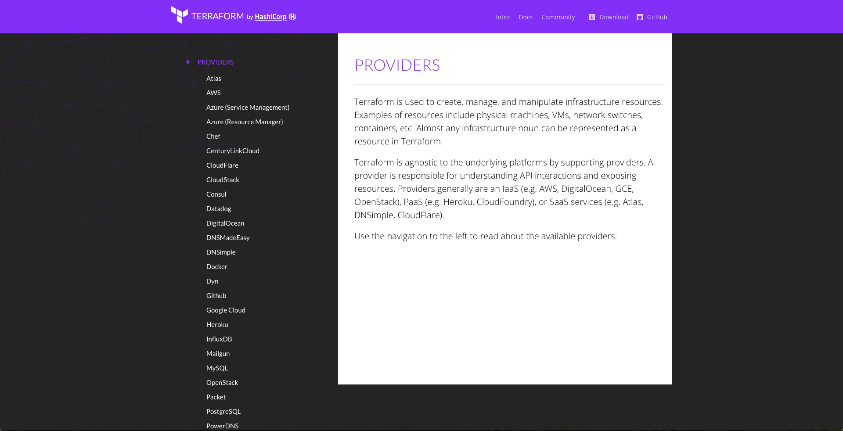
Terraform supports many providers (cloud agnostic)

Slide 94
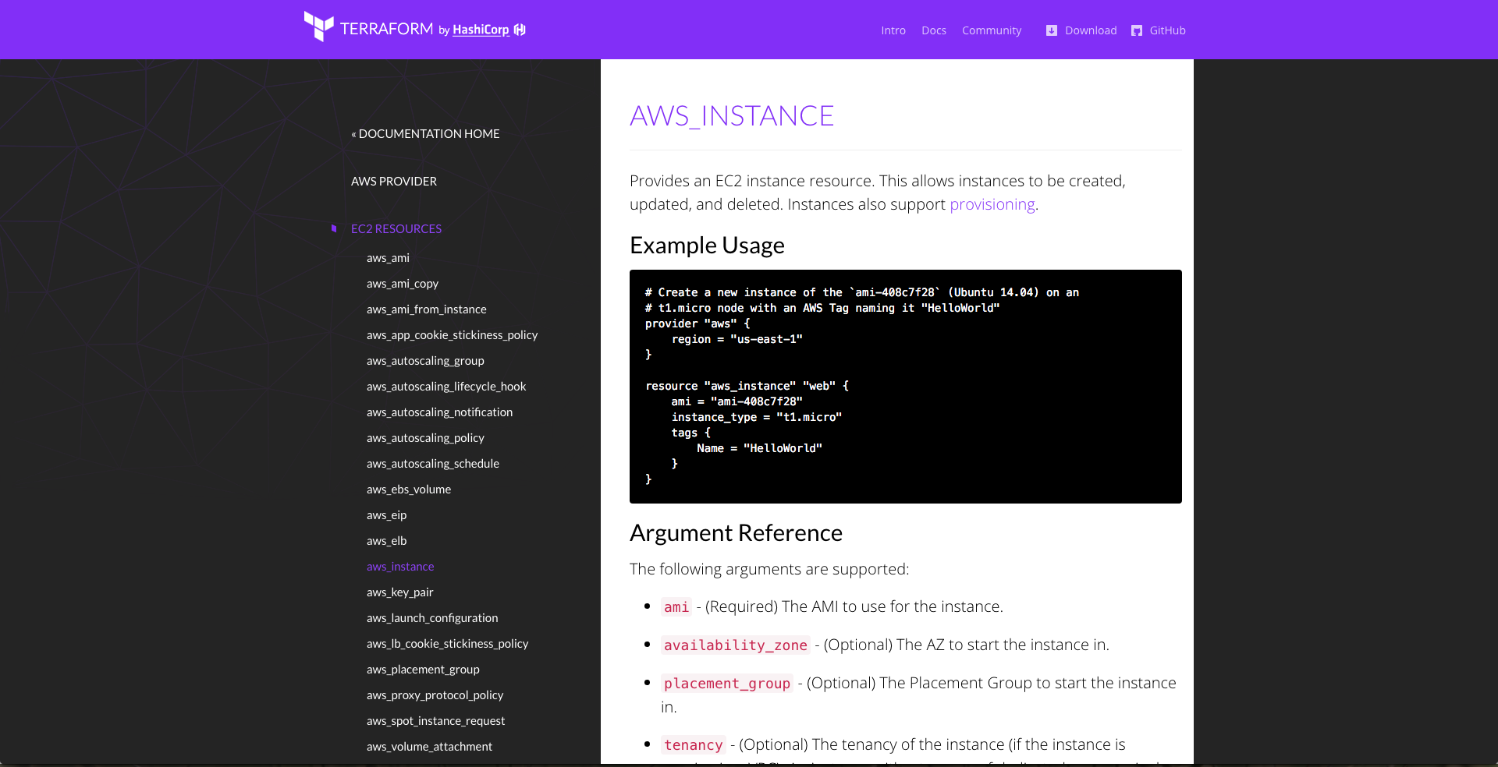
And many resources for each provider

Slide 95
You define infrastructure as code in Terraform templates

Slide 96
provider "aws" {
region = "us-east-1"
}
resource "aws_instance" "example" {
ami = "ami-408c7f28"
instance_type = "t2.micro"
}
This template creates a single EC2 instance in AWS

Slide 97
> terraform plan
+ aws_instance.example
ami: "" => "ami-408c7f28"
instance_type: "" => "t2.micro"
key_name: "" => "<computed>"
private_ip: "" => "<computed>"
public_ip: "" => "<computed>"
Plan: 1 to add, 0 to change, 0 to destroy.
Use the plan command to see what you’re about to deploy

Slide 98
> terraform apply
aws_instance.example: Creating...
ami: "" => "ami-408c7f28"
instance_type: "" => "t2.micro"
key_name: "" => "<computed>"
private_ip: "" => "<computed>"
public_ip: "" => "<computed>”
aws_instance.example: Creation complete
Apply complete! Resources: 1 added, 0 changed, 0 destroyed.
Use the apply command to apply the changes

Slide 99
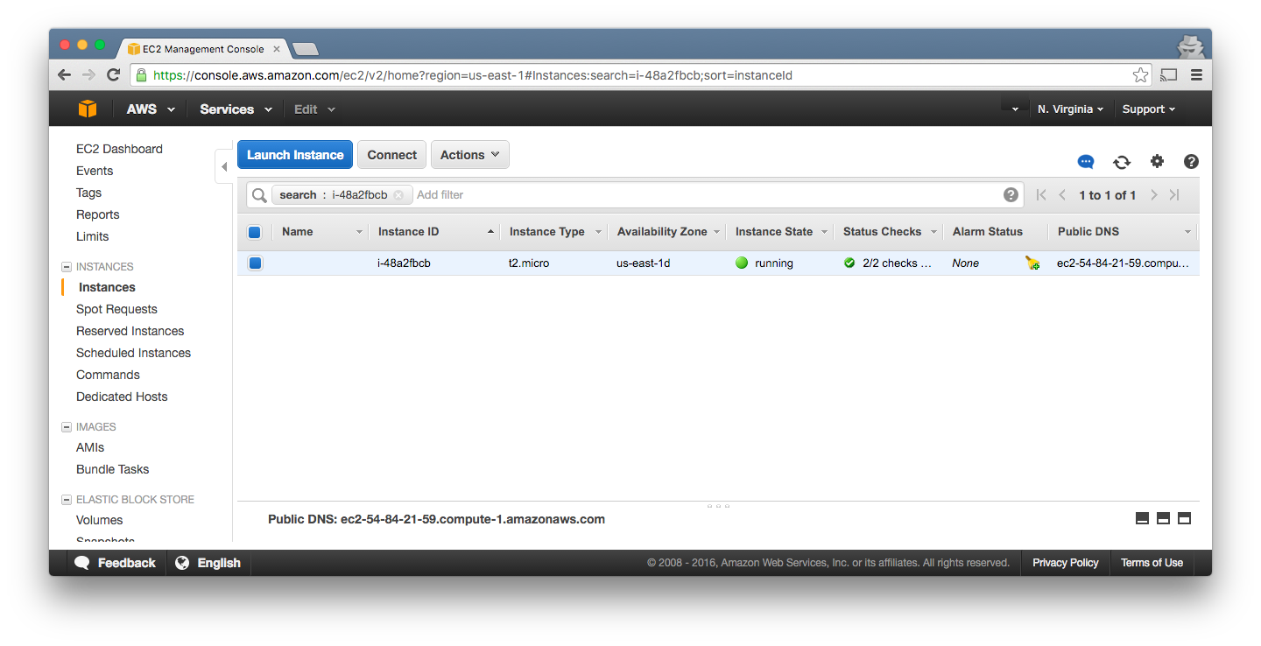
Now our EC2 instance is running!

Slide 100
resource "aws_instance" "example" {
ami = "ami-408c7f28"
instance_type = "t2.micro"
tags {
Name = "terraform-example"
}
}
Let’s give the EC2 instance a tag with a readable name

Slide 101
> terraform plan
~ aws_instance.example
tags.#: "0" => "1"
tags.Name: "" => "terraform-example"
Plan: 0 to add, 1 to change, 0 to destroy.
Use the plan command again to verify your changes

Slide 102
> terraform apply
aws_instance.example: Refreshing state...
aws_instance.example: Modifying...
tags.#: "0" => "1"
tags.Name: "" => "terraform-example"
aws_instance.example: Modifications complete
Apply complete! Resources: 0 added, 1 changed, 0 destroyed.
Use the apply command again to deploy those changes

Slide 103
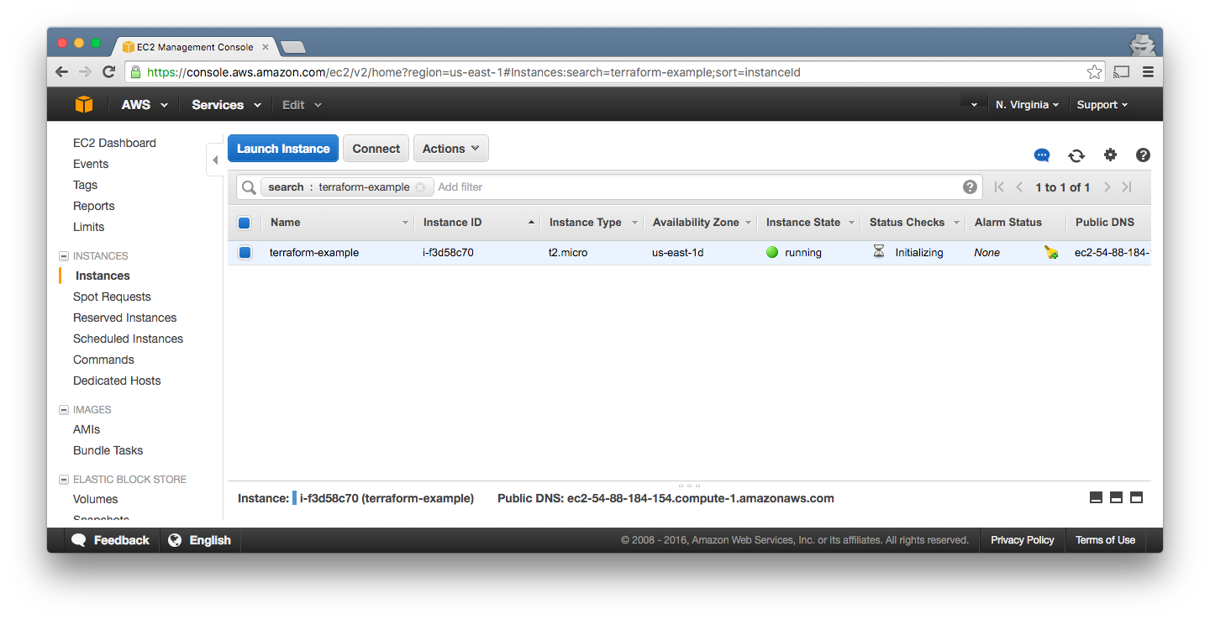
Now our EC2 instance has a tag!

Slide 104
resource "aws_elb" "example" {
name = "example"
availability_zones = ["us-east-1a", "us-east-1b"]
instances = ["${aws_instance.example.id}"]
listener {
lb_port = 80
lb_protocol = "http"
instance_port = "${var.instance_port}"
instance_protocol = "http”
}
}
Let’s add an Elastic Load Balancer (ELB).

Slide 105
resource "aws_elb" "example" {
name = "example"
availability_zones = ["us-east-1a", "us-east-1b"]
instances = ["${aws_instance.example.id}"]
listener {
lb_port = 80
lb_protocol = "http"
instance_port = "${var.instance_port}"
instance_protocol = "http”
}
}
Terraform supports variables, such as var.instance_port

Slide 106
resource "aws_elb" "example" {
name = "example"
availability_zones = ["us-east-1a", "us-east-1b"]
instances = ["${aws_instance.example.id}"]
listener {
lb_port = 80
lb_protocol = "http"
instance_port = "${var.instance_port}"
instance_protocol = "http"
}
}
As well as dependencies like aws_instance.example.id

Slide 107
resource "aws_elb" "example" {
name = "example"
availability_zones = ["us-east-1a", "us-east-1b"]
instances = ["${aws_instance.example.id}"]
listener {
lb_port = 80
lb_protocol = "http"
instance_port = "${var.instance_port}"
instance_protocol = "http"
}
}
It builds a dependency graph and applies it in parallel.

Slide 108
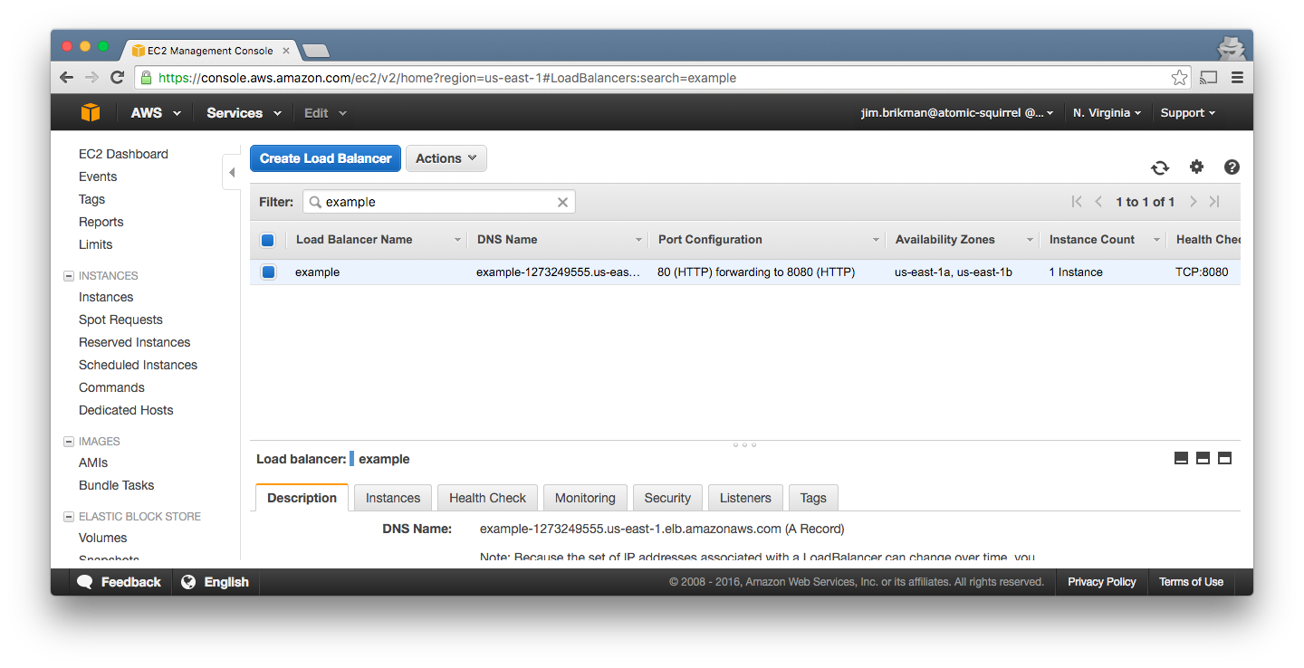
After running apply, we have an ELB!

Slide 109
> terraform destroy
aws_instance.example: Refreshing state... (ID: i-f3d58c70)
aws_elb.example: Refreshing state... (ID: example)
aws_elb.example: Destroying...
aws_elb.example: Destruction complete
aws_instance.example: Destroying...
aws_instance.example: Destruction complete
Apply complete! Resources: 0 added, 0 changed, 2 destroyed.
Use the destroy command to delete all your resources

Slide 110
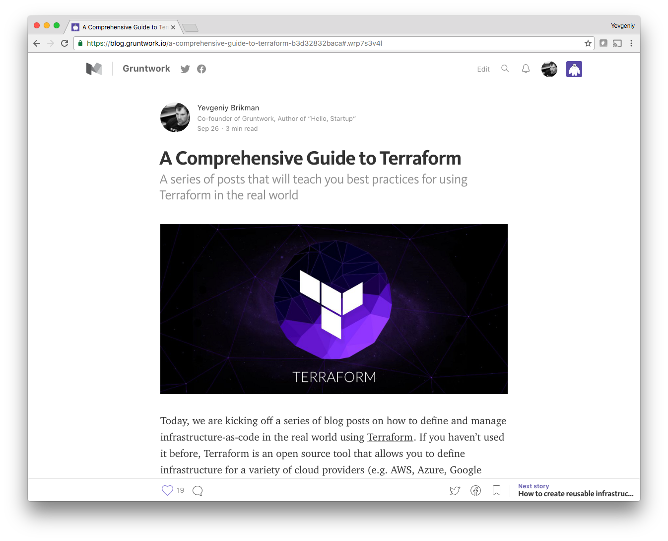
For more info, check out The Comprehensive Guide to Terraform

Slide 111
Advantages of Terraform:
Concise, readable syntax
Reusable code: inputs, outputs, modules
Plan command!
Cloud agnostic
Very active development

Slide 112
Disadvantages of Terraform:
Maturity
Collaboration on Terraform state is hard (but terragrunt makes it easier)
No rollback
Poor secrets management

Slide 113
Outline
Microservices
Docker
Terraform
ECS
Recap

Slide 114
EC2 Container Service (ECS) is a way to run Docker on AWS

Slide 115



{
"name": "example",
"image": "foo/example",
"cpu": 1024,
"memory": 2048,
"essential": true,
}
{
"cluster": "example",
"serviceName": ”foo",
"taskDefinition": "",
"desiredCount": 2
}
ECS Agent
ECS Scheduler
ECS Tasks
ECS Task Definition
ECS Service Definition
EC2 Instance
ECS Cluster
ECS Overview

Slide 116
EC2 Instance
ECS Cluster: several servers managed by ECS
ECS Cluster

Slide 117
EC2 Instance
Typically, the servers are in an Auto Scaling Group
Auto Scaling Group

Slide 118


EC2 Instance
Which can automatically relaunch failed servers
Auto Scaling Group

Slide 119
ECS Agent
EC2 Instance
Each server must run the ECS Agent
ECS Cluster

Slide 120
{
"name": "example",
"image": "foo/example",
"cpu": 1024,
"memory": 2048,
"essential": true,
}
ECS Agent
ECS Task Definition
EC2 Instance
ECS Task: Docker container(s) to run, resources they need
ECS Cluster

Slide 121
{
"name": "example",
"image": "foo/example",
"cpu": 1024,
"memory": 2048,
"essential": true,
}
{
"cluster": "example",
"serviceName": ”foo",
"taskDefinition": "",
"desiredCount": 2
}
ECS Agent
ECS Task Definition
ECS Service Definition
EC2 Instance
ECS Service: long-running ECS Task & ELB settings
ECS Cluster

Slide 122
{
"name": "example",
"image": "foo/example",
"cpu": 1024,
"memory": 2048,
"essential": true,
}
{
"cluster": "example",
"serviceName": ”foo",
"taskDefinition": "",
"desiredCount": 2
}
ECS Agent
ECS Task Definition
ECS Service Definition
ECS Scheduler
ECS Tasks
EC2 Instance
ECS Scheduler: Deploys Tasks across the ECS Cluster
ECS Cluster

Slide 123
{
"name": "example",
"image": "foo/example",
"cpu": 1024,
"memory": 2048,
"essential": true,
}
{
"cluster": "example",
"serviceName": ”foo",
"taskDefinition": "",
"desiredCount": 2
}
ECS Agent
ECS Task Definition
ECS Service Definition
ECS Scheduler
ECS Tasks
EC2 Instance
It will also automatically redeploy failed Services
ECS Cluster

Slide 124


ECS Agent
User
ECS Tasks
EC2 Instance
You can associate an ALB or ELB with each ECS service
ECS Cluster

Slide 125
ECS Agent
User
ECS Tasks
EC2 Instance
This lets you distribute traffic across multiple ECS Tasks
ECS Cluster

Slide 126
v1
v1
ECS Agent
v1
v2
User
ECS Tasks
EC2 Instance
Which allows zero-downtime deployment
ECS Cluster

Slide 127
ECS Agent
ECS Tasks
EC2 Instance
As well as a simple form of service discovery
ECS Cluster

Slide 128

ECS Agent
ECS Tasks
CloudWatch
EC2 Instance
You can use CloudWatch alarms to trigger auto scaling
ECS Cluster

Slide 129
ECS Agent
ECS Tasks
CloudWatch
EC2 Instance
You can scale up by running more ECS Tasks
ECS Cluster

Slide 130
ECS Agent
ECS Tasks
CloudWatch
EC2 Instance
And by adding more EC2 Instances
ECS Cluster

Slide 131
ECS Agent
ECS Tasks
CloudWatch
EC2 Instance
And scale back down when load is lower
ECS Cluster

Slide 132
Let’s deploy our microservices in ECS using Terraform

Slide 133
EC2 Instance
Define the ECS Cluster as an Auto Scaling Group (ASG)
ECS Cluster

Slide 134
resource "aws_ecs_cluster" "example_cluster" {
name = "example-cluster"
}
resource "aws_autoscaling_group" "ecs_cluster_instances" {
name = "ecs-cluster-instances"
min_size = 3
max_size = 3
launch_configuration =
"${aws_launch_configuration.ecs_instance.name}"
}

Slide 135
ECS Agent
EC2 Instance
Ensure each server in the ASG runs the ECS Agent
ECS Cluster

Slide 136
# The launch config defines what runs on each EC2 instance
resource "aws_launch_configuration" "ecs_instance" {
name_prefix = "ecs-instance-"
instance_type = "t2.micro"
# This is an Amazon ECS AMI, which has an ECS Agent
# installed that lets it talk to the ECS cluster
image_id = "ami-a98cb2c3”
}
The launch config runs AWS ECS Linux on each server in the ASG

Slide 137
{
"name": "example",
"image": "foo/example",
"cpu": 1024,
"memory": 2048,
"essential": true,
}
ECS Agent
ECS Task Definition
EC2 Instance
Define an ECS Task for each microservice
ECS Cluster

Slide 138
resource "aws_ecs_task_definition" "rails_frontend" {
family = "rails-frontend"
container_definitions = <<EOF
[{
"name": "rails-frontend",
"image": "brikis98/rails-frontend:v1",
"cpu": 1024,
"memory": 768,
"essential": true,
"portMappings": [{"containerPort": 3000, "hostPort": 3000}]
}]
EOF
}
Rails frontend ECS Task

Slide 139
resource "aws_ecs_task_definition" "sinatra_backend" {
family = "sinatra-backend"
container_definitions = <<EOF
[{
"name": "sinatra-backend",
"image": "brikis98/sinatra-backend:v1",
"cpu": 1024,
"memory": 768,
"essential": true,
"portMappings": [{"containerPort": 4567, "hostPort": 4567}]
}]
EOF
}
Sinatra Backend ECS Task

Slide 140
{
"name": "example",
"image": "foo/example",
"cpu": 1024,
"memory": 2048,
"essential": true,
}
{
"cluster": "example",
"serviceName": ”foo",
"taskDefinition": "",
"desiredCount": 2
}
ECS Agent
ECS Task Definition
ECS Service Definition
EC2 Instance
Define an ECS Service for each ECS Task
ECS Cluster

Slide 141
resource "aws_ecs_service" "rails_frontend" {
family = "rails-frontend"
cluster = "${aws_ecs_cluster.example_cluster.id}"
task_definition =
"${aws_ecs_task_definition.rails-fronted.arn}"
desired_count = 2
}
Rails Frontend ECS Service

Slide 142
resource "aws_ecs_service" "sinatra_backend" {
family = "sinatra-backend"
cluster = "${aws_ecs_cluster.example_cluster.id}"
task_definition =
"${aws_ecs_task_definition.sinatra_backend.arn}"
desired_count = 2
}
Sinatra Backend ECS Service

Slide 143
ECS Agent
User
ECS Tasks
EC2 Instance
Associate an ELB with each ECS Service
ECS Cluster

Slide 144
resource "aws_elb" "rails_frontend" {
name = "rails-frontend"
listener {
lb_port = 80
lb_protocol = "http"
instance_port = 3000
instance_protocol = "http"
}
}
Rails Frontend ELB

Slide 145
resource "aws_ecs_service" "rails_frontend" {
(...)
load_balancer {
elb_name = "${aws_elb.rails_frontend.id}"
container_name = "rails-frontend"
container_port = 3000
}
}
Associate the ELB with the Rails Frontend ECS Service

Slide 146
resource "aws_elb" "sinatra_backend" {
name = "sinatra-backend"
listener {
lb_port = 4567
lb_protocol = "http"
instance_port = 4567
instance_protocol = "http"
}
}
Sinatra Backend ELB

Slide 147
resource "aws_ecs_service" "sinatra_backend" {
(...)
load_balancer {
elb_name = "${aws_elb.sinatra_backend.id}"
container_name = "sinatra-backend"
container_port = 4567
}
}
Associate the ELB with the Sinatra Backend ECS Service

Slide 148
ECS Agent
ECS Tasks
EC2 Instance
Set up service discovery between the microservices
ECS Cluster

Slide 149
resource "aws_ecs_task_definition" "rails_frontend" {
family = "rails-frontend"
container_definitions = <<EOF
[{
...
"environment": [{
"name": "SINATRA_BACKEND_PORT",
"value": "tcp://${aws_elb.sinatra_backend.dns_name}:4567"
}]
}]
EOF
}
Pass the Sinatra Bckend ELB URL as env var to Rails Frontend

Slide 150
{
"name": "example",
"image": "foo/example",
"cpu": 1024,
"memory": 2048,
"essential": true,
}
{
"cluster": "example",
"serviceName": ”foo",
"taskDefinition": "",
"desiredCount": 2
}
ECS Agent
ECS Task Definition
ECS Service Definition
ECS Scheduler
ECS Tasks
EC2 Instance
It’s time to deploy!
ECS Cluster

Slide 151
> terraform apply
aws_ecs_cluster.example_cluster: Creating...
name: "" => "example-cluster"
aws_ecs_task_definition.sinatra_backend: Creating...
...
Apply complete! Resources: 17 added, 0 changed, 0 destroyed.
Use the apply command to deploy the ECS Cluster & Tasks

Slide 152
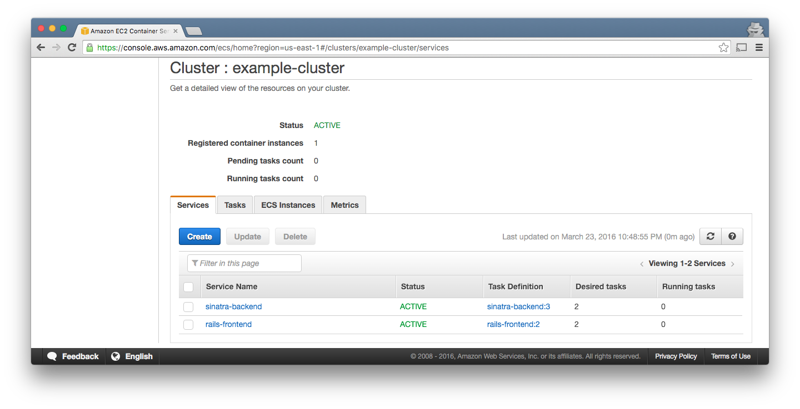
See the cluster in the ECS console

Slide 153
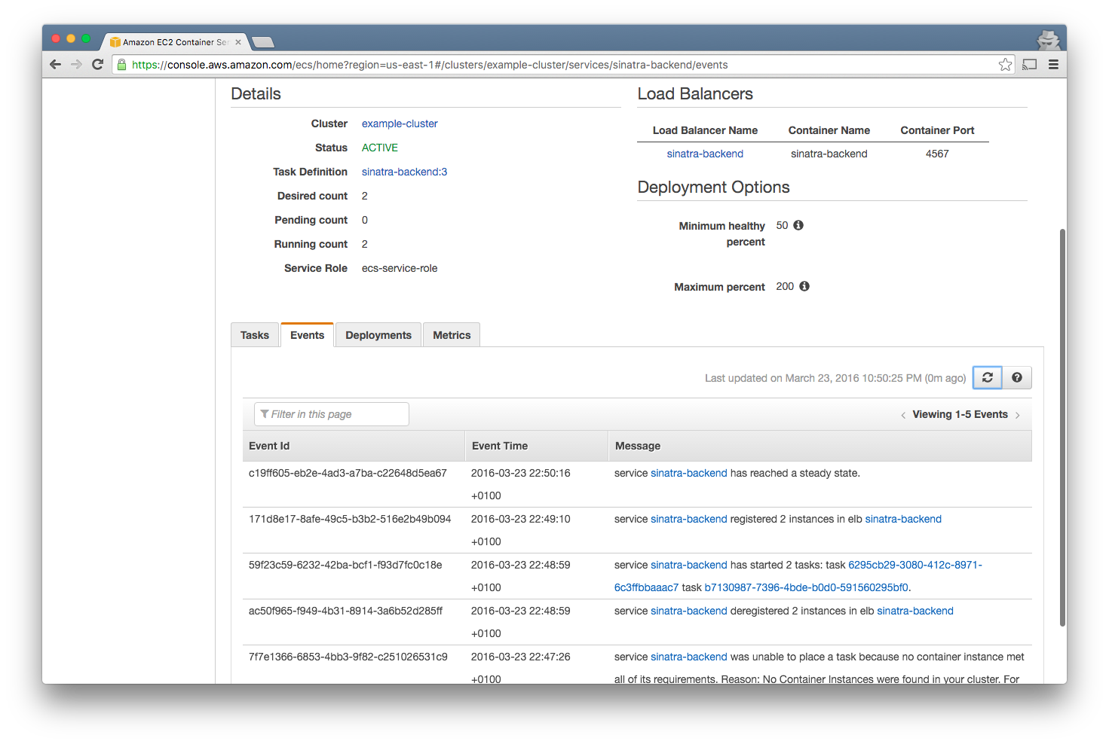
Track events for each Service

Slide 154
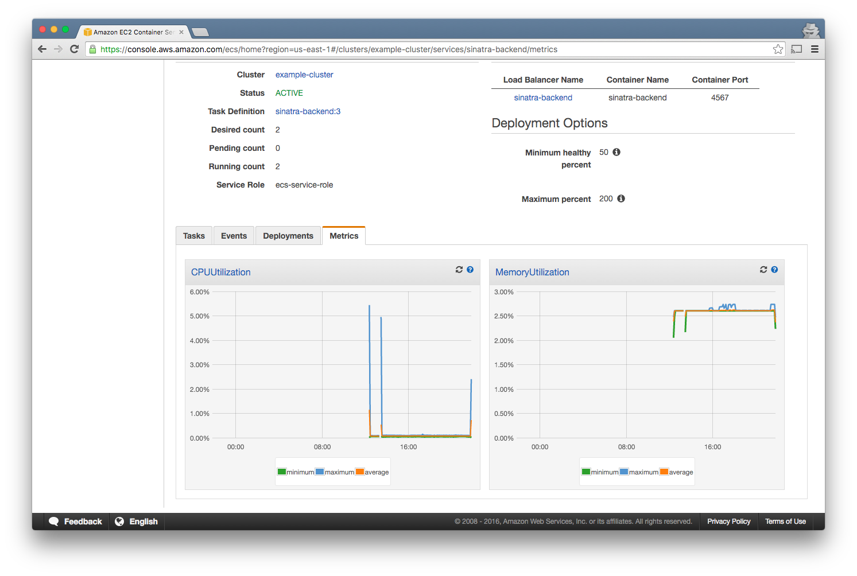
As well as basic metrics

Slide 155
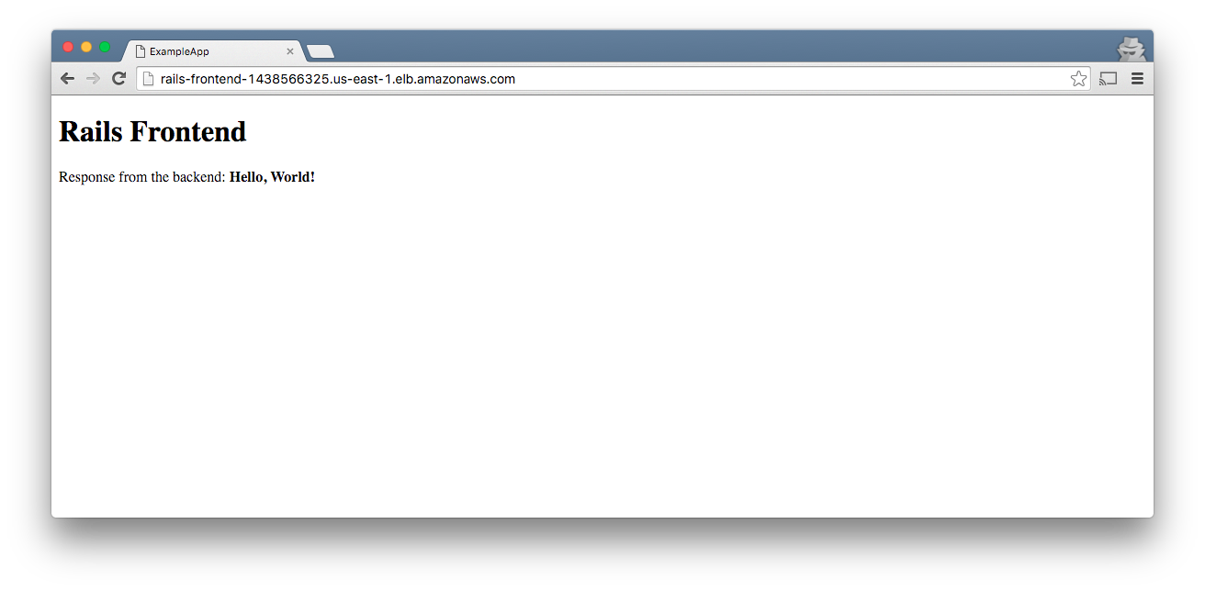
Test the rails-frontend

Slide 156
resource "aws_ecs_task_definition" "sinatra_backend" {
family = "sinatra-backend"
container_definitions = <<EOF
[{
"name": "sinatra-backend",
"image": "brikis98/sinatra-backend:v2",
...
}
To deploy a new image, just update the docker tag

Slide 157
> terraform plan
~ aws_ecs_service.sinatra_backend
task_definition: "arn...sinatra-backend:3" => "<computed>"
-/+ aws_ecs_task_definition.sinatra_backend
arn: "arn...sinatra-backend:3" => "<computed>"
container_definitions: "bb5352f" => "2ff6ae" (forces new resource)
revision: "3" => "<computed>”
Plan: 1 to add, 1 to change, 1 to destroy.
Use the plan command to verify the changes

Slide 158

Apply the changes and you’ll see v2.

Slide 159
Advantages of ECS:
One of the simplest Docker cluster management tools
Almost no extra cost if on AWS
Pluggable scheduler
Auto-restart of instances & Tasks
Automatic ALB/ELB integration

Slide 160
Disadvantages of ECS:
UI is so-so
Minimal monitoring built-in
ALB is broken

Slide 161
Outline
Microservices
Docker
Terraform
ECS
Recap

Slide 162
Benefits of infrastructure-as-code:
Reuse
Automation
Version control
Code review
Testing
Documentation

Slide 163
Slides and code from this talk:
ybrikman.com/speaking

Slide 164
For more info, see
Hello, Startup
hello-startup.net

Slide 165
And
Terraform:
Up & Running
terraformupandrunning.com

Slide 166
For DevOps help, see Gruntwork
gruntwork.io

Slide 167

Questions?

